Slide 1

SAMVIDA
An AI-powered platform that helps citizens discover
government schemes they are eligible for and understand their benefits.
Team: ERROR 404
Members: Rushank Natekar, Kashinath Chavan, Rajas Sawant, Lisma Pereira
Hackathon track: JAN JEEVAN: Technology for Everyday Life & Real-World Indian Challenges

Slide 2

Problem Statement
Problem → Affected users → Consequence — Citizens (especially students, rural and low‑income households) face fragmentation and complexity, which leads to missed benefits and reduced access to welfare.
  Citizens struggle to discover relevant government welfare schemes.
  Eligibility conditions are written in complex legal or administrative language that ordinary users find difficult to interpret.
  Information is fragmented across multiple portals, PDFs and local offices.
  Eligible citizens often miss benefits because they cannot determine which schemes apply to their situation.
Clear, accessible discovery is essential to close gaps between policy and public benefit uptake.

Slide 3



Solution - SAMVIDA
SAMVIDA is an accessible AI-assisted platform that converts a user's basic profile into personalised government scheme recommendations and plain-language benefit explanations.
User Input
Profile Analysis
Scheme Matching
Recommended Schemes
Personalised discovery
Eligibility-based recommendations
Clear benefit information
Users enter basic profile details and receive tailored scheme matches.
Automated matching against eligibility rules to surface relevant schemes.
Plain-language summaries and actionable next steps for each recommendation.

Slide 4
Technology & Implementation
Implementation matches the GitHub repository: a modern frontend stack with a backend database and eligibility-processing components. All stated technologies are taken from the repository.
1
2
3
1. User Interface
2. Application Logic
3. Database
React + TypeScript frontend built with Vite and Tailwind CSS for fast, accessible UI.
Client-side and server-side logic performs eligibility parsing and matching; AI-assisted components where implemented in repo.
Supabase used as the primary database and auth layer for scheme data and user profiles.
4
5
4. Government Scheme Data
5. Results
Structured scheme records stored in the DB; new records can be added incrementally from verified sources.
Personalized scheme recommendations presented to the user with benefit summaries and next steps.
Repository: https://github.com/Rushank2106/Samvid

Slide 5
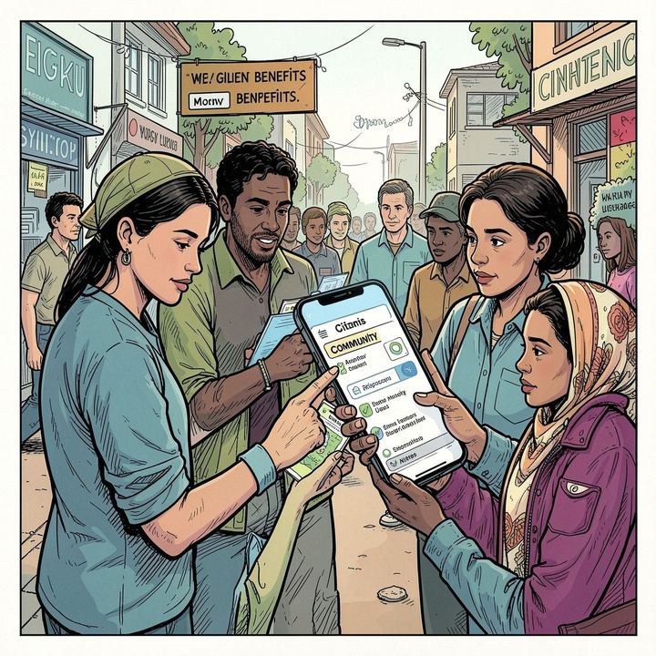
Feasibility, Scalability & Impact
Feasibility
Web-first deployment using scalable, open-source- friendly technologies. Incremental rollouts and iterative testing possible from prototype to production.
Scalability
Extensible scheme database, multi-region data imports, multilingual UI, and improved recommendation models over time.
Target users
Citizens, students, rural communities, low-income households, and users unfamiliar with government portals.
Impact
Improves awareness of available welfare schemes.
Reduces information barriers and confusion.
Helps eligible users find benefits faster and understand next steps.
Supports incremental policy reach and better civic outcomes.
Design emphasises accessibility and plain language to maximise real-world uptake.

Slide 6

Prototype & Future Scope
Prototype highlights: onboarding form, profile dashboard, scheme
Future scope
1
More comprehensive scheme DB, multilingual support, voice interaction, verified API integrations, mobile app, and improved personalization.
recommendation cards with plain-language summaries, and step-by-step benefit guidance.
Example workflow: Sign up → Enter basic details → View matched schemes → Read benefits → Follow enrolment steps
Repository(source):https://github.com/Rushank2106/Samvid
Next steps
2
Extend data ingestion pipelines, pilot in a target region, run user testing with underserved communities, and iterate recommendation logic.
View Source Code
QR code
Thank you — Questions?

